Slide 1
ORM
(Object-Relational Mapping)

Slide 2
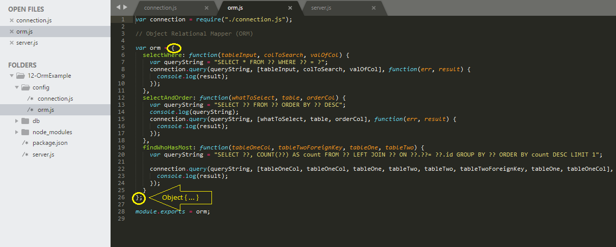
Object:
Variable “orm” is an object with methods that we export from orm.js and import into server.js

Slide 3
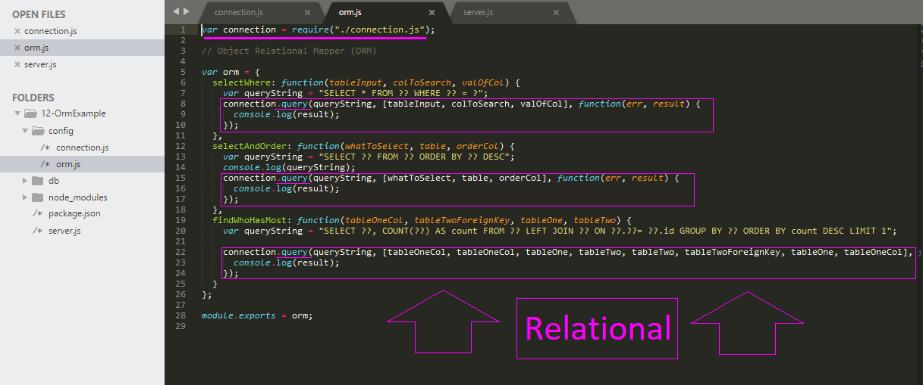
Relational:
ORM methods “relate” the connection exported from connection.js to queries called in server.js.

Slide 4
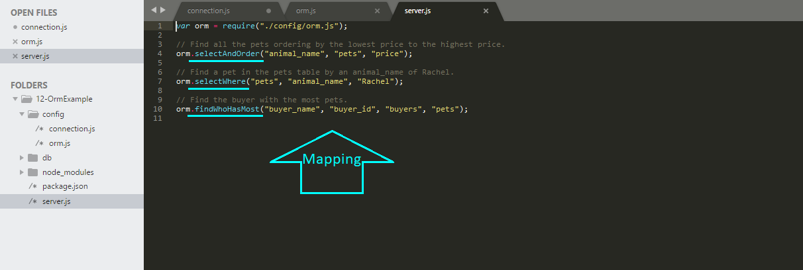
Mapping:
Our queries in server.js are “mapped” through the imported orm object and modify the connection from connection.js according to the methods defined in orm.js

Slide 5
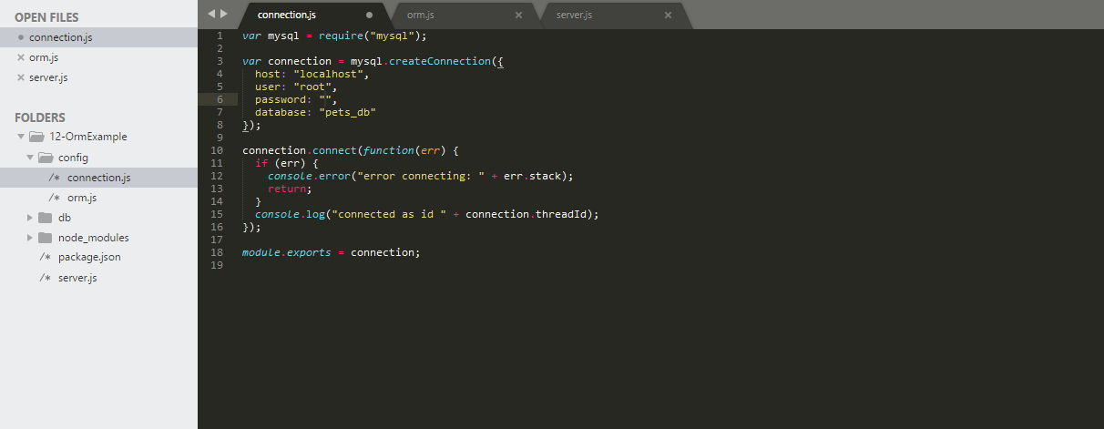
ORM (cont.):
Variable “connection” is an exported “virtual object database” that allows us to query/modify our database row and columns without affecting persistence.
i.e. Database properties are not changed
connection.js (connection) < > orm.js (orm) < > server.js (queries)

Slide 6
Resources:
Activity 14.12
Familiarize yourself with the working example in this activity and feel free to use it as starter code for other projects—no need to code something twice if it works once!

